Slide 1
PSYC100 GENERAL PSYCHOLOGY
mEMORY

Slide 2
Learning Outcomes
What is memory?
Encoding, Storage and Retrieval
The Multi-Store Model (MSM)
Episodic, Semantic and Procedural memory
The Working Memory Model (WMM)
The Levels of Processing Model (LOP)
Theories of Forgetting

Slide 3
What is memory?
Memory, like learning, is a hypothetical construct denoting three distinguishable but interrelated processes:
● registration (or encoding) – the transformation of sensory input (such as a sound or visual image) into a form which allows it to be entered into (or registered in) memory.
● storage – the operation of holding or retaining information in memory.
● retrieval – the process by which stored information is extracted from memory.

Slide 4
These three processes work to manage how we encode, retain, and recall information in our memory.
Registration (Encoding): This is the initial step where sensory information is transformed into a format that can be stored in memory. It involves selective attention and relates to questions like "How is sensory information processed in a way that allows it to be stored?" or "How are things remembered?"
Storage: This process involves retaining information in memory over time. It relates to questions such as "Where are our memories kept?" and "Is there more than one kind of memory?"
Retrieval: This is the process of recovering stored information when needed. It connects to questions like "Are there different kinds of remembering?" "What do we remember?" and "Why do we forget?"

Slide 5
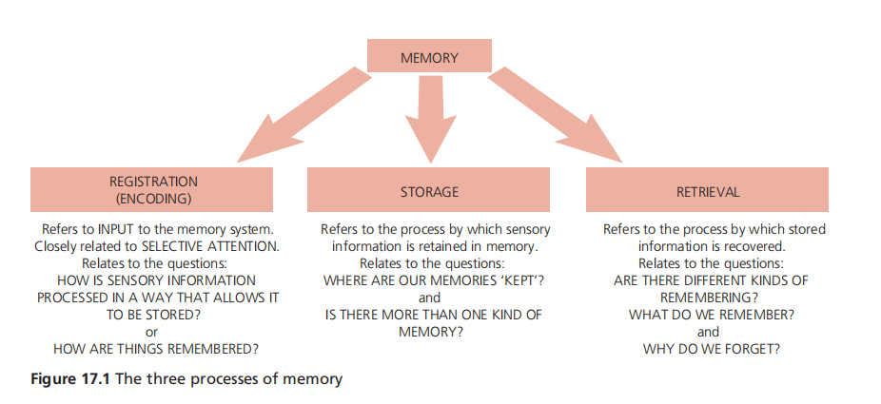

Slide 6
I - ENCODING (REGISTRATION)
Some information is encoded automatically without us being aware of it. Most
people probably can recall what they had for breakfast yesterday, even though
they haven’t tried to remember it. Other information will only become encoded if you pay attention to it.
There are three ways of encoding information to be used by our memory system:
➢ acoustic encoding – encoding of sound
➢ visual encoding – encoding of picture images
➢ semantic encoding – encoding of meaning

Slide 7
Examples
Acoustic Encoding: If you are repeating someone’s phone number aloud.
Visual Encoding: Picturing the face of someone you met or imagining the layout of a room you visited.
Semantic Encoding: Understanding and recalling that "justice" means fairness or remembering the concept of "photosynthesis" as how plants make food.

Slide 8
II - STORAGE
There are 3 forms of storage:
1. Sensory memory - This is the initial stage where sensory information (sight, sound, etc.) is briefly held for a very short period, typically less than a second to a few seconds. It acts as a buffer, allowing us to process and decide what to pay attention to.
2. Short-term memory - This holds information for a limited time, usually 20-30 seconds, and has a small capacity (about 5-9 items). It’s where we actively think about or manipulate information, like remembering a phone number long enough to dial it.
3. Long-term memory - This stores information for an extended period, potentially a lifetime, with a vast capacity. It includes knowledge, skills, and experiences, and is accessed when we recall past events or learned facts.

Slide 9
STM vs LTM
● capacity – how much information can be stored
● duration – how long the information can be held in storage
● coding – how sensory input is represented by the memory system.

Slide 10
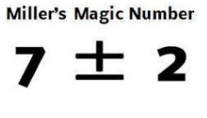
Short-term memory CAPACITY
George Miller (1956) emphasized that the capacity of the STM is approximately “seven plus or minus two” pieces of information – digits, words etc. (the magic number 7+/-2).

Slide 11
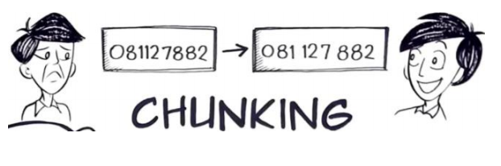
Short-term memory CAPACITY
Chunking of information can lead to an increase in the STM capacity. This is the reason why a hyphenated phone number is EASIER to remember than a single long number.

Slide 12
Short-term memory DURATION
The duration of STM is thought to be 15-30 seconds. If information is not rehearsed within 18 to 30 seconds whilst in STM, it is lost due to its limited duration. Short-term memory encodes information acoustically through repetition of information. If we rehearse (repeat) this information (say it over and over to ourselves), we can store it in our short-term memory for many minutes and it can then be transferred to the long-term memory store (almost indefinitely) (Peterson & Peterson, 1959).

Slide 13
Short-term memory CODING
Mainly acoustic (e.g. When you try to remember a phone number by repeating it in your head); Some semantic (encoding by meaning); Visual is also possible (e.g. briefly remembering an image or shape.)

Slide 14
Long-term memory CAPACITY & DURATION
The capacity of LTM could be unlimited as it can hold a potentially unlimited amount of information.
Duration: Long-term memory can store memories for minutes or up to an entire lifetime.

Slide 15
Long-term memory CODING
Encoding in long-term memory is largely semantic (e.g. You remember that “a whale is a mammal” because of what it means, not how it sounds), but can be visual (e.g. remembering what your childhood home looks like) or acoustic (e.g. remembering the tune of a favorite song).

Slide 16
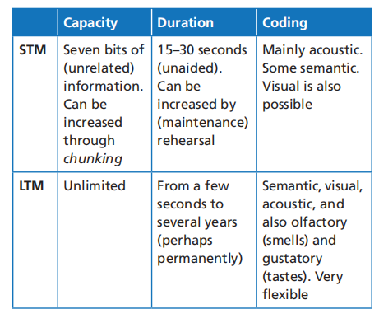

Slide 17
RETRIEVAL
Retrieval refers to getting information out of storage. If we cannot remember something, it may be because we are unable to retrieve it.
e.g. Ebbinghaus study (1885)
e.g. Standing study (1973)

Slide 18
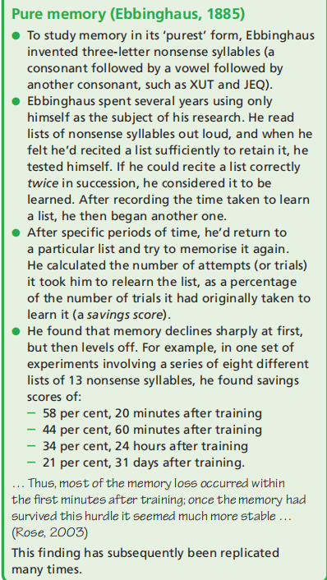
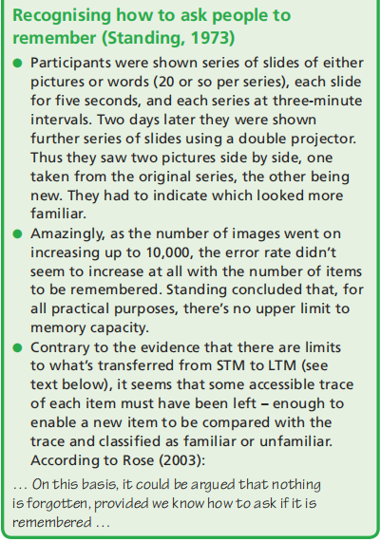

Slide 19
The Multi-Store Model (MSM)
Richard Atkinson and Richard Shiffrin developed the Multi-store Model of Memory (1968) by drawing conclusions from memory experiments conducted by other researchers. This model is a structural model and Atkinson and Shiffrin described memory as having separate stores.
By pulling together this research, they were able to identify three distinctly different stores in our memory system:
• the sensory register (or sensory memory)
• short-term memory
• long-term memory

Slide 20
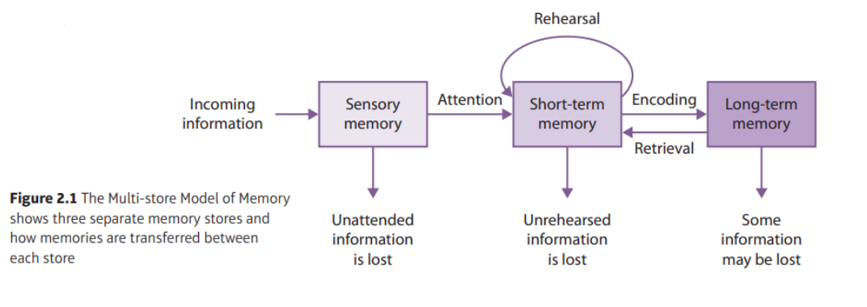
The Multi-Store Model (MSM)
Atkinson and Shiffrin proposed that memory stores differ from each other in the way information is encoded, their capacity and duration, and how information is retrieved.

Slide 21
Experimental studies of STM and LTM
1. Experimental studies of STM and LTM
2. Studies of coding
3. Studies of brain-damaged patients.

Slide 22
1. Experimental studies of STM and LTM
The Serial Position Effect (Murdock, 1962): Participants typically recalled those items from the end of the list first, and got more of these correct than earlier items (the recency effect). Items from the beginning of the list were recalled quite well relative to those in the middle (the primacy effect), but not as well as those at the end. Poorest recall is for items in the middle.
Primacy effect due to LTM, recency effect due to STM.

Slide 23
2. Studies of coding
Remember acoustic coding in STM, semantic coding in LTM!
However, Miller and Selfridge (1950) has demonstrated that knowledge of semantic and grammatical structure (presumably stored in LTM) is used to aid recall from STM. Therefore, an acoustic code isn’t the only one used in STM.

Slide 24
3. Studies of brain-damaged patients.
If STM and LTM really are distinct, then there should be certain kinds of brain damage which impair one without affecting the other. One such form of brain damage is anterograde amnesia.
HM case where after the brain operation, he was unable to form new explicit long-term memories, however his immediate or working memory remained functional (STM intact, old LTM intact, new LTM severely impaired).
HM's deficits strongly support the MSM by demonstrating a clear dissociation between STM and LTM, suggesting they are separate systems

Slide 25
Episodic, Semantic & Procedural Memory
The multi-store model of memory, as supported by cases like HM, distinguishes between short-term and long-term memory, with long-term memory (LTM) further divided into subtypes based on the type of information stored and how it is retrieved. The three main types of long-term memory are episodic, semantic, and procedural.

Slide 26
Episodic Memory
The storage and recall of personally experienced events tied to specific times and places. These are autobiographical memories that include contextual details (e.g., "what," "when," "where," and associated emotions). It is a type of explicit (declarative) memory, meaning it can be consciously recalled and described.
Autobiographical episodic memory - Personal, specific events from one’s life with rich contextual details (e.g., Recalling your first day of university, what your lecturer looked like, and how you felt.)
Flashbulb Memories: Highly vivid, detailed memories of emotionally significant events (e.g., Recalling how you felt when you found out about the death of a celebrity or leader (e.g., Michael Jackson, Princess Diana).

Slide 27
Semantic Memory
Involves the storage of general knowledge, facts, and concepts not tied to personal experiences or specific contexts. It is also an explicit (declarative) memory type, consciously recalled, but lacks the temporal and spatial specificity of episodic memory.
e.g. knowing that 2+2=4 or that "cat" refers to a furry animal

Slide 28
Procedural Memory
Involves the unconscious recall of skills, habits, and motor routines learned through practice. It is a type of implicit (non-declarative) memory, meaning it is expressed through performance rather than conscious recollection.
e.g. riding a bicycle, chess player recognizing patterns, brushing teeth in the morning,

Slide 29
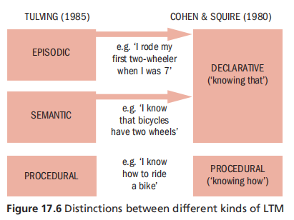

Slide 30
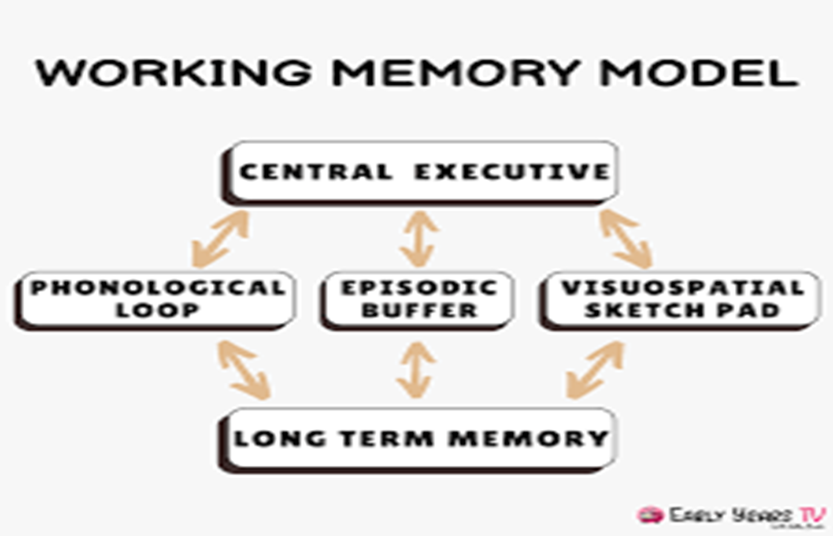
The Working Memory Model (WMM)
Baddeley & Hitch (1974; 2000) - this model focuses on how short-term memory (STM) actually works in practice. Instead of being just a “storage box,” it’s seen as an active system that manipulates and processes information.
Central executive: Acts like a manager; Directs attention and coordinates the other subsystems; Has limited capacity.
Phonological Loop: stores spoken words for a short time; allows rehearsal
Visuo-Spatial Sketchpad: Holds and manipulates images
Episodic Buffer: Integrates information from different sources (sound, vision, long-term memory) into a single “episode.”

Slide 31
MSM vs WMM
Multi-Store Model - STM is a single, passive store; focus on the structure of memory (where info goes); Simple, linear, “box-like” model.
  e.g. remembering a shopping list - You hear the list of items → it enters sensory memory → you rehearse it in STM (silently repeat “milk, eggs, bread”) → with enough rehearsal, it transfers to LTM.
Working-Memory Model - STM is an active system with multiple components; focus on the process of memory (how info is handled); More detailed and dynamic model.
  e.g. remembering a shopping list - Phonological Loop: you repeat “milk, eggs, bread” in your head; Central Executive: focuses your attention and tells you not to get distracted; Episodic Buffer: links “milk” with the image of the fridge at home being empty.

Slide 32
The Levels of Processing Model (LOP)
Remember MSM argues we need to reherse the information in order to transfer it from STM to LTM. However, Jenkins (1974) Incidental learning - remembering without rehersing. Craik and Lockhart (1972) argues what matters is the kind of rehearsal or processing.
So, rather than rehearsal in STM, you can achieve LTM via deep, semantic processing.
e.g. If you’re trying to remember the word “elephant”:
MSM → You repeat “elephant” in STM until it transfers to LTM.
LOP → You think about what an elephant looks like, how big it is, or connect it with the zoo (semantic processing), which makes it memorable.

Slide 33
Key evidence LOP
Craik & Tulving (1975): Participants were given a list of words, but instead of being asked to memorize them, they answered different kinds of questions about each word. The questions encouraged different levels of processing:
Shallow (structural) → e.g., “Is the word in capital letters?”
Intermediate (phonemic) → e.g., “Does the word rhyme with ‘cat’?”
Deep (semantic) → e.g., “Does the word fit in this sentence: ‘The ____ walked into the room’?”
After answering these questions, participants were given a surprise recognition test (asked which words they had seen before).
Words processed at a deep, semantic level were remembered much better than words processed at shallow or phonemic levels. Depth of processing, not just rehearsal, determines how well information is remembered (STRONG EVIDENCE AGAINST MSM!).

Slide 34
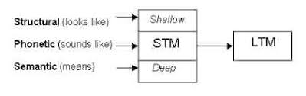

Slide 35
Theories of Forgetting
Forgetting can occur at the encoding, storage or retrieval stages.
What prevents information staying in STM long enough to be transferred to LTM?
  Decay theory: Suggests that memories fade over time if they are not accessed or rehearsed (STM + LTM)
  Displacement theory: new incoming information pushes out older information as we exceed the limited capacity of STM
  Interference theory: forgetting occurs when new or old information disrupts the recall of other memories (LTM). There are two types:
    Proactive Interference: When old information interferes with learning or remembering new information. For example, if you used to have an old phone number and it keeps popping into your mind when you try to recall your new one AND Learning a new password is harder because your old password keeps coming to mind..
    Retroactive Interference: When new information interferes with the ability to recall older information. For instance, learning a new language might make it harder to remember vocabulary from a previously learned language AND You learn new dance steps, then forget some of the old ones..

Slide 36
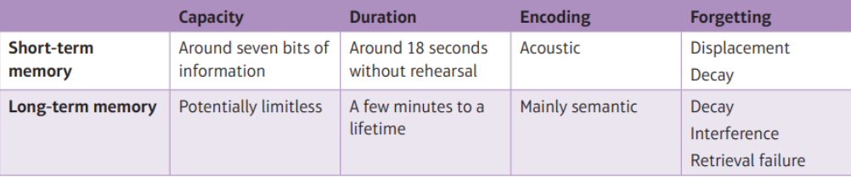

Slide 37
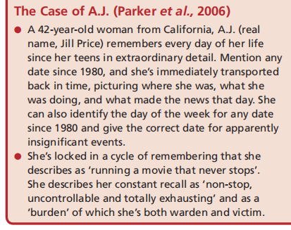
Efficient forgetting?
According to Schacter (2002), efficient forgetting is a crucial part of having a fully functioning memory; this is lacking in people with hyperthymestic syndrome (or highly superior autobiographical memory/HSAM).

Slide 38
Lecture Summary
What is memory? Encoding, storage, retrieval
The Multi-Store Model (MSM) – Atkinson & Shiffrin
Episodic, Semantic and Procedural memory
The Working Memory Model (WMM) - Baddeley & Hitch
The Levels of Processing Model (LOP) - Craik and Lockhart
Theories of Forgetting – Decay, displacement, interference

